Slide 1
Mark-recapture distance sampling (MRDS) in Distance 7.1
Setting up Distance for MRDS
Setting up a Distance project for MRDS
Data requirements
MRDS analyses

Slide 2
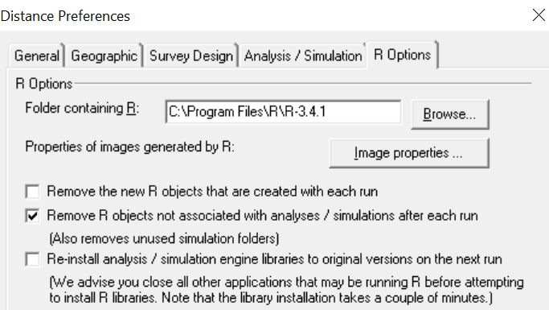
Setting up Distance
You need a copy of R installed on your computer http://www.r-project.org/
Currently, the required version is R 3.4.1
Check:
Distance automatically installs mrds R library when you run an MRDS analysis

Slide 3
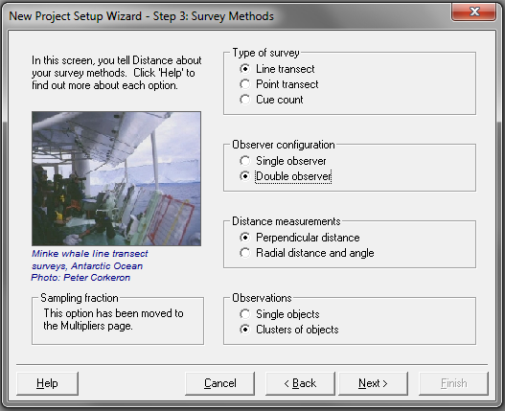
Project setup
Choose “Double observer” in New project Setup Wizard

Slide 4
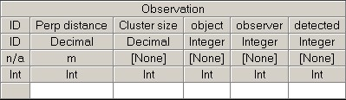
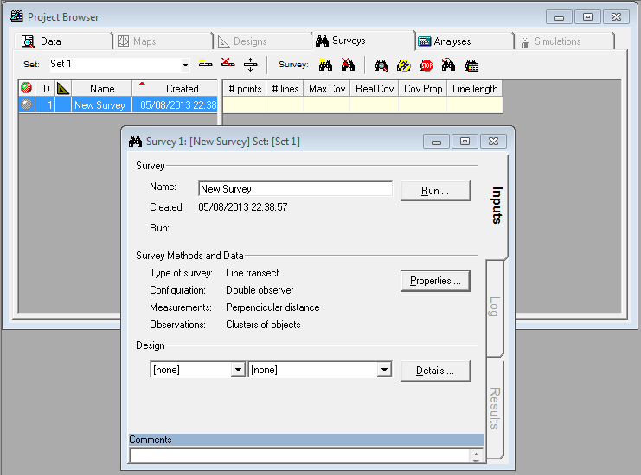
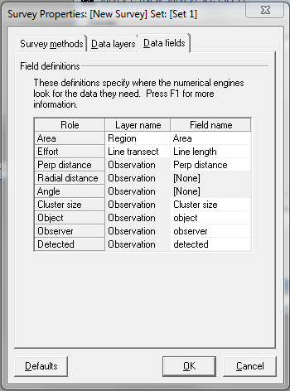
Project setup
This causes 3 extra fields to be added to the Observation layer
And their roles defined in the default Survey object

Slide 5
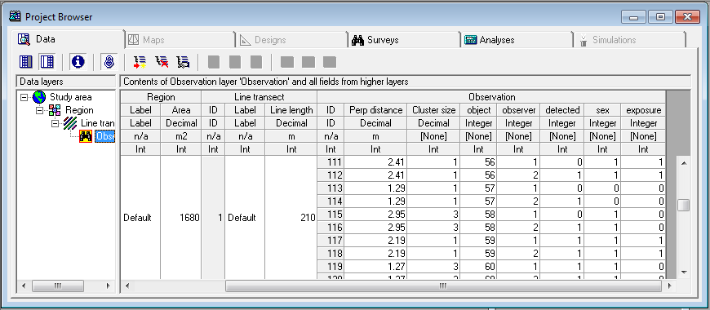
Data requirements
Observation data must have:
2 rows per object – one for Observer 1 and one for Observer 2
Fields for:
object ID
observer (1 or 2)
detected (1=yes, 0=no)
Additional covariate data can go in fields at the appropriate level
Example: (golf tee project)
the 3 new required fields
observation-level covariates – fields created during data import

Slide 6
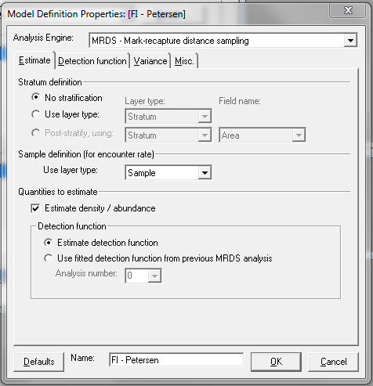
MRDS analyses
Select MRDS engine in Model Definition
Estimate tab
Stratification options as for CDS/MCDS engines – but no post-stratification for now
Quantities to estimate
Can choose not to estimate density (saves time during model selection)
Can choose to estimate a detection function, or to use a fitted function from a previous analysis.
Useful to apply a detection function estimated with all data to a subset of the data
See manual for details.

Slide 7
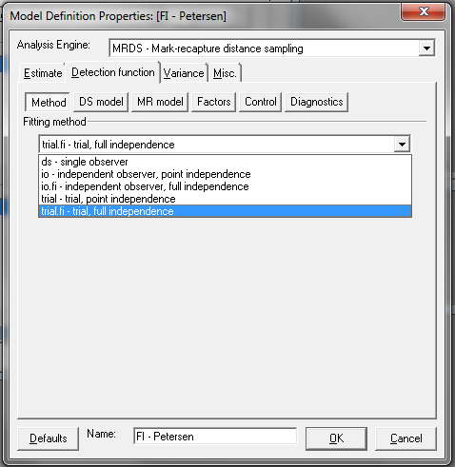
Detection function tab
5 methods at present
ds – CDS and MCDS (but no adjustment terms)
IO (independent observer) – both point and full independence
Trial – both point and full independence
Choice of method determines which model you need
DS model = distance sampling model.
half-normal or hazard rate, optionally with covariates in the scale parameter
MR model = mark recapture model
GLM with logit link

Slide 8
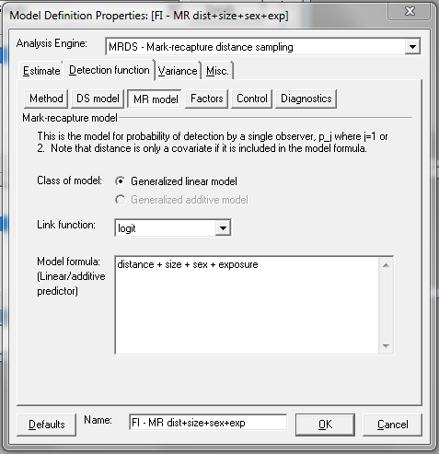
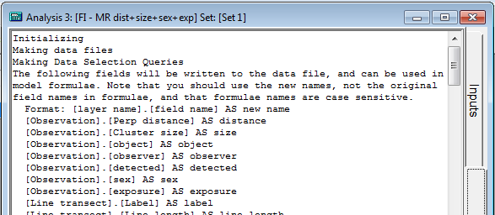
Model formulae
Type in variable names joined by “+” (main effect), “:” (interaction), “*” (main effect + interaction)
Note that some fields get renamed:
distance, size, object, observer, detected
fields from layers above the observation layer
Tip – look in Analysis Details log to see new names

Slide 9
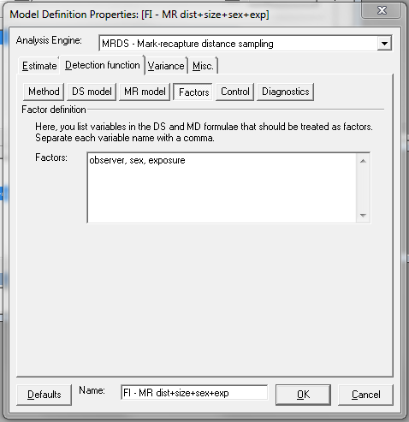
Factors
Need to specify which variables in the formulae are factors
Tip: type in all possible factors in the first Model Definition and this will be used as the basis of all subsequent definitions

Slide 10
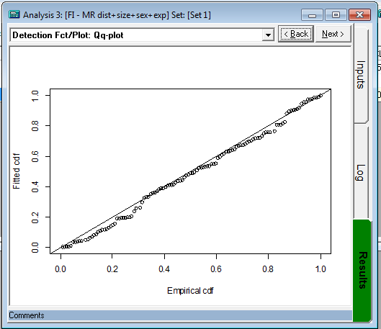
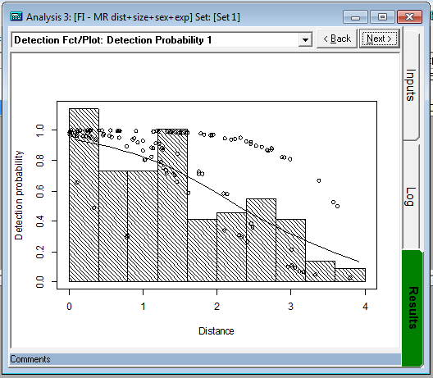
Results
Produces
diagnostics (qq plots, detection function plots, goodness-of-fit tests)
parameter estimates, and estimated density and abundance
Can customize plots (in Preferences)
Plots stored as graphics files in a folder “R” within project data folder
Results optionally stored in an .Rdata file in the “R” folder, so if you know R software you can access them (Preferences)

